Slide 1

Digital Signal Processing
Section 5
Operations on matrix
Lecture 2 Exercises
Asmaa fathy

Slide 2
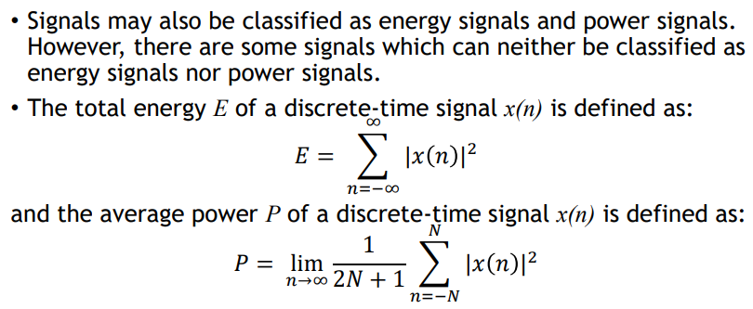
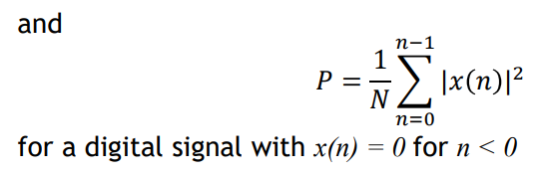
Energy and Power Signals

Slide 3
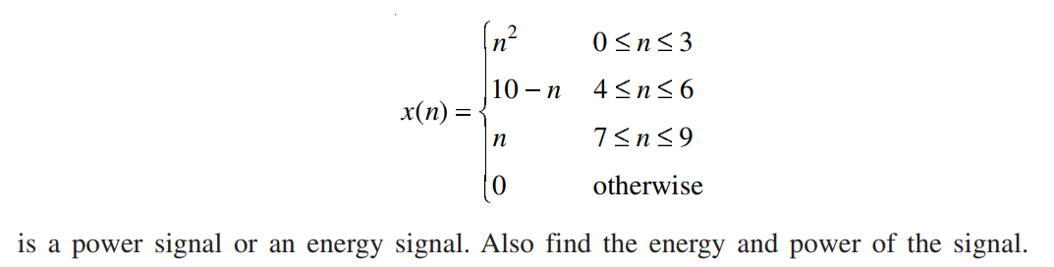
EXAMPLE 1.6
Find whether the signal

Slide 4
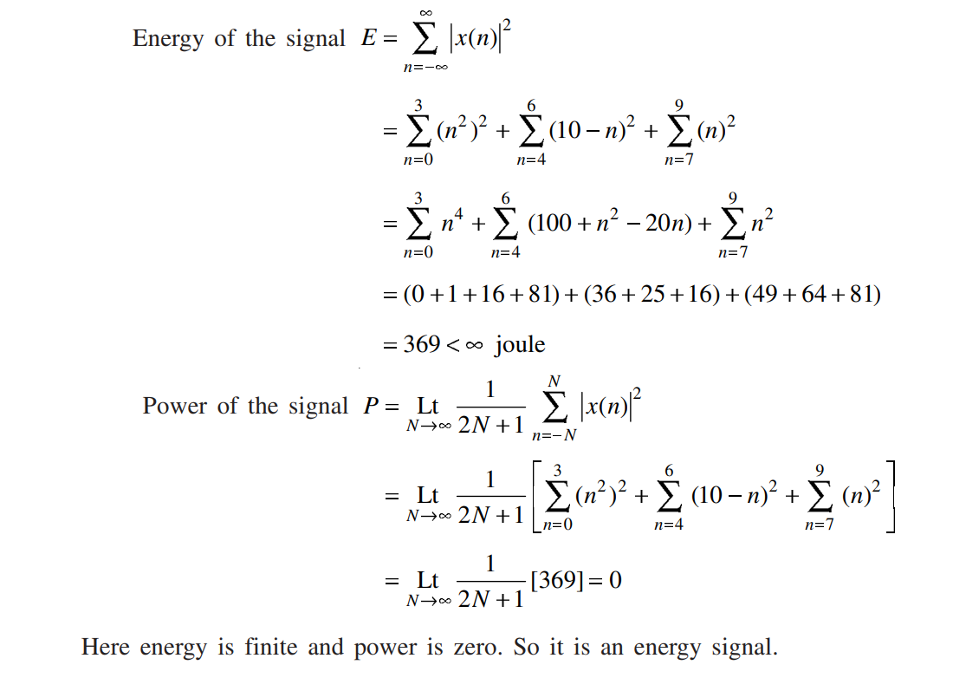
Solution

Slide 5
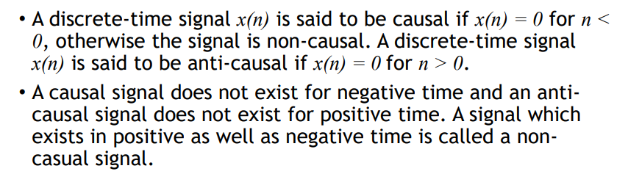
Causal and Non- Causal Signals

Slide 6

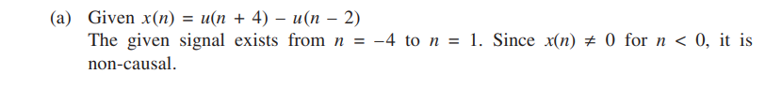
EXAMPLE 1.7
Find whether the signal causal or non-causal
Solution

Slide 7
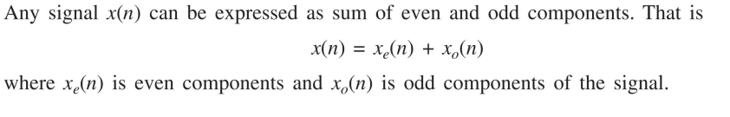
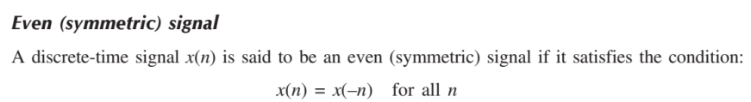
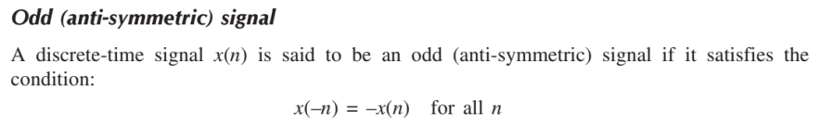
Even and Odd Signals

Slide 8
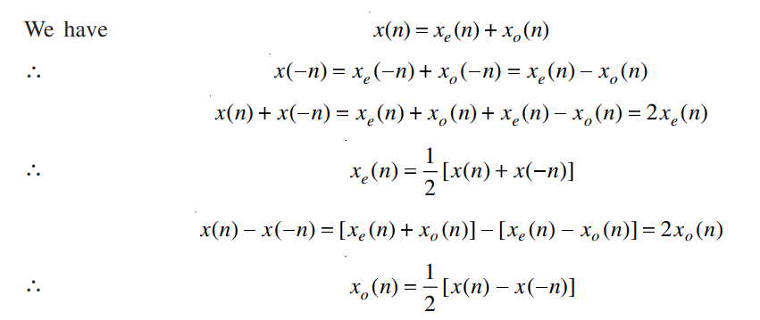
Evaluation of even and odd parts of signal

Slide 9
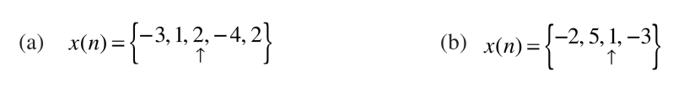
EXAMPLE 1.8
Find the even and odd components of the following signals:

Slide 10
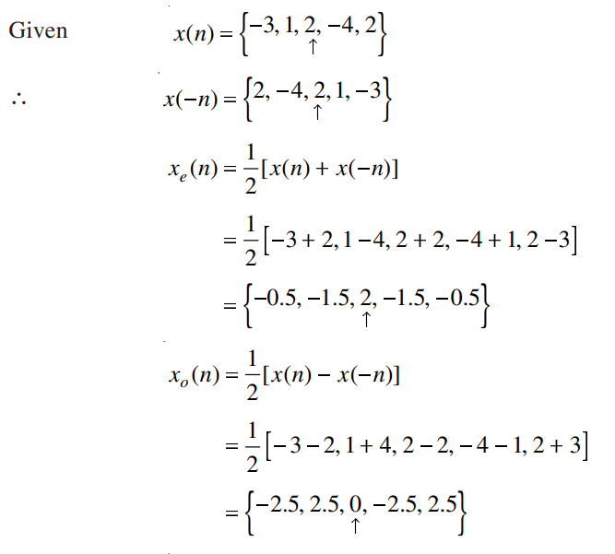
Solution

Slide 11
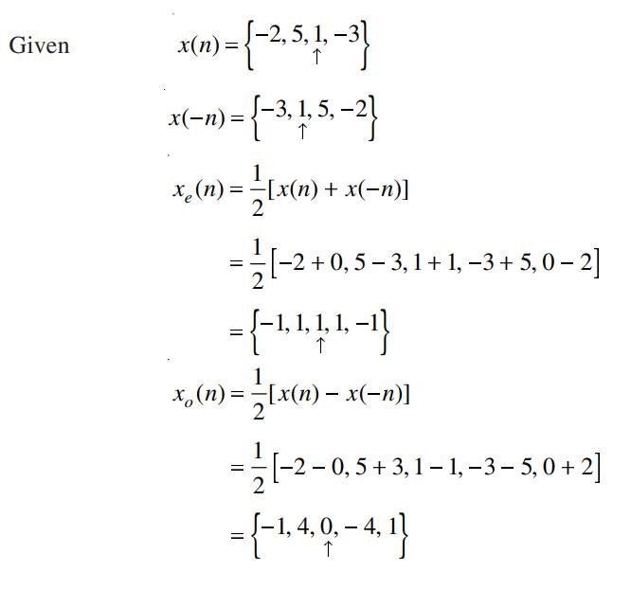
Solution

Slide 12
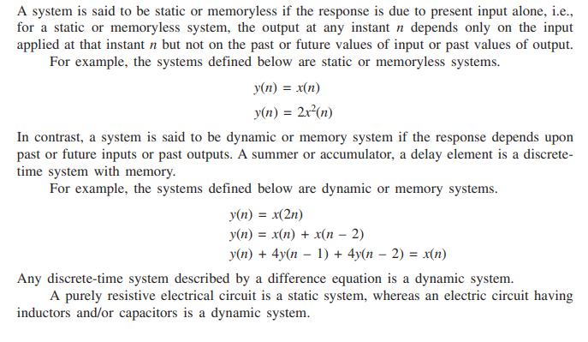
Static and Dynamic Systems

Slide 13
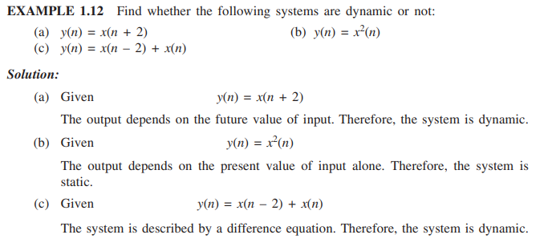

Slide 14
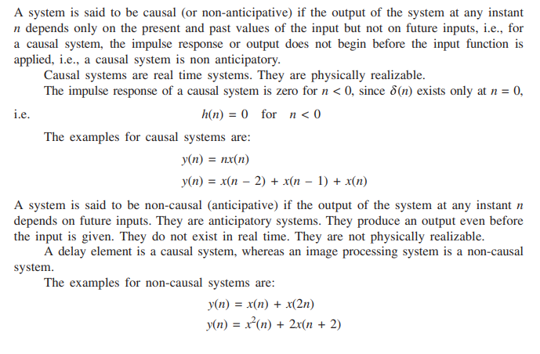
Causal and Non-Causal Systems

Slide 15
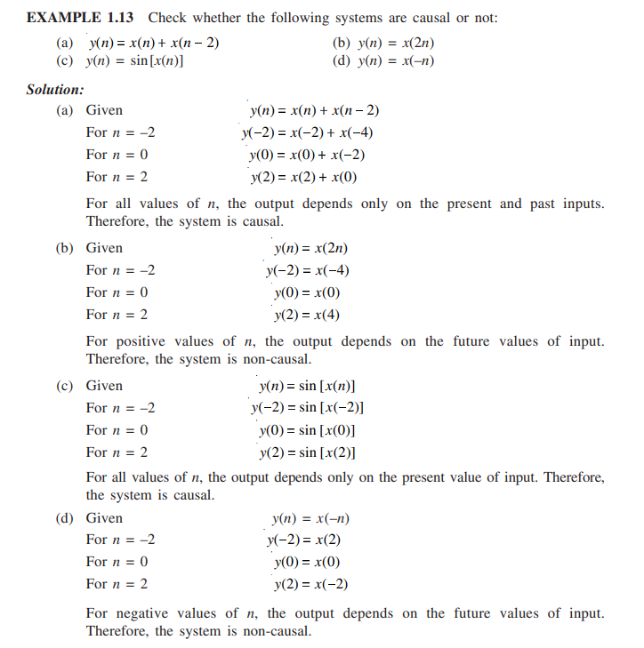

Slide 16
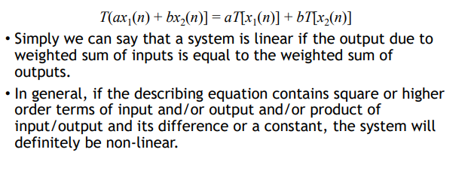
Linear and Non-Linear Systems

Slide 17
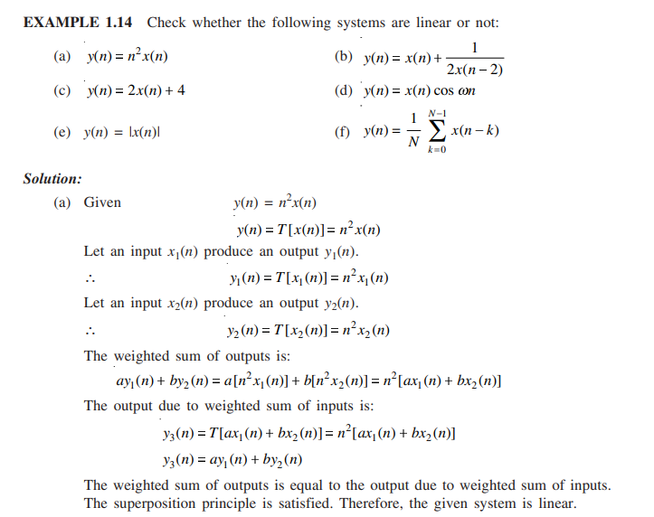

Slide 18
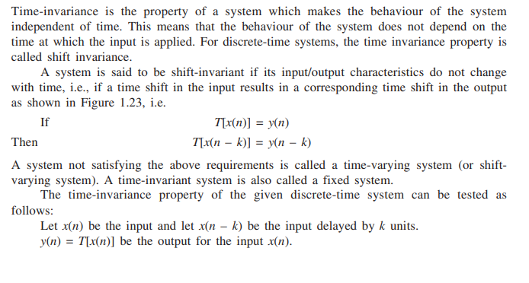
Shift-invariant and Shift varying Systems

Slide 19
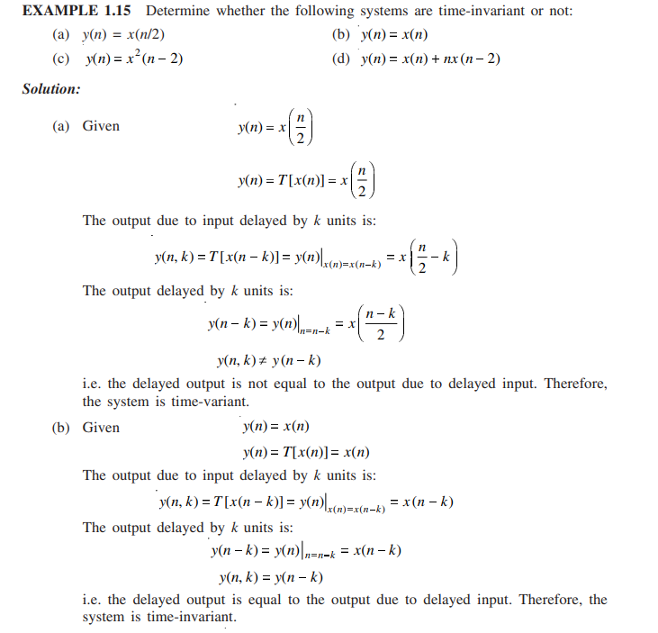

Slide 20
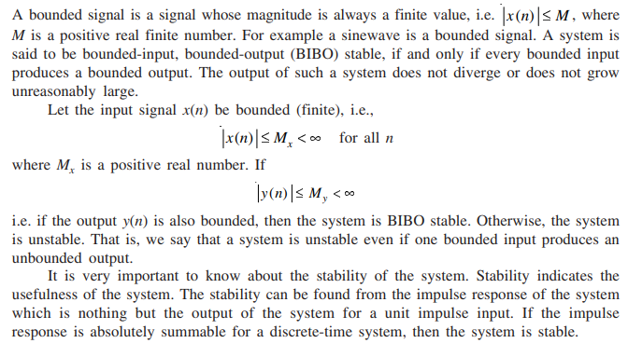
Stable and Unstable Systems

Slide 21
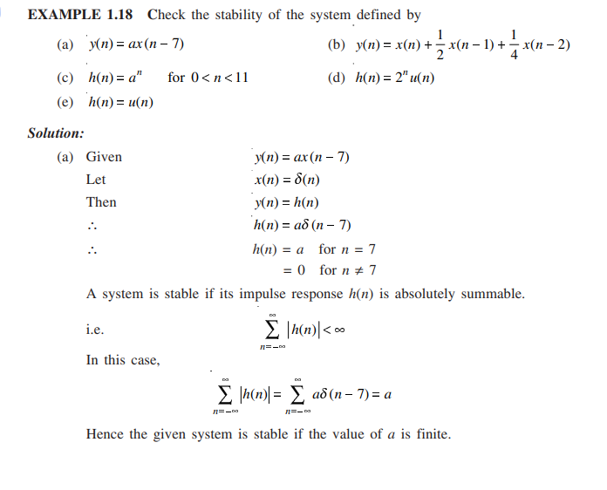

Slide 22
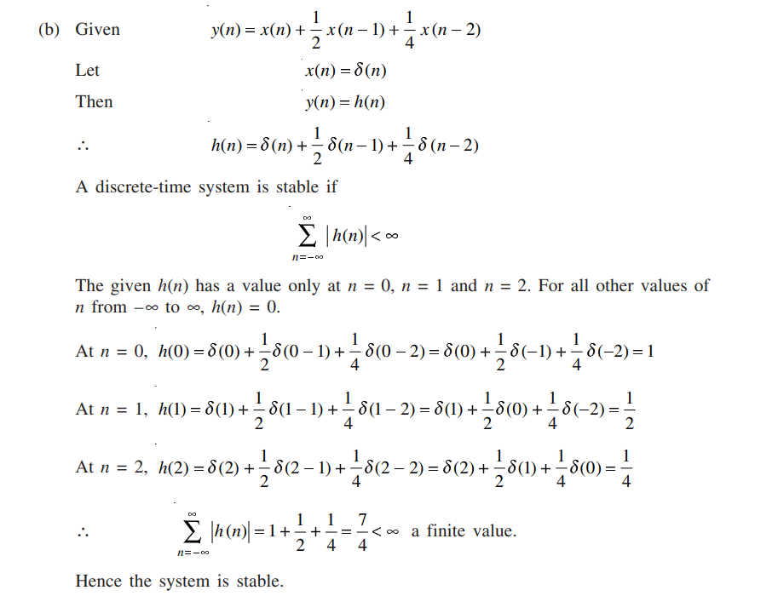

Slide 23
Thank You

